Slide 1
Final Project
Anne Aeschliman

Slide 2
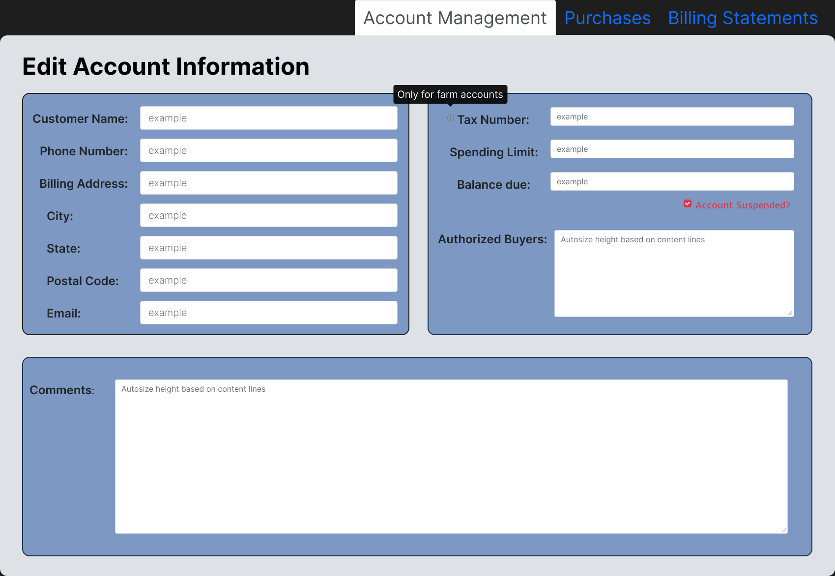

Slide 3
Product and Business Description
Purpose-What is the function of this feature and the tasks it does?
Manage information needed for a customer account
Scope-What limitations exist for this feature?
Shouldn’t be used by anyone but managers
Managers know what they’re doing
Information must be given voluntarily, can’t look through outside databases for customer info
Account suspension, tax number, and comments need to be coded throughout the rest of the POS system.
Stakeholders-Who is involved in the development of this feature and their roles?
Field bosses, region managers
Store managers
The IT Department

Slide 4
Product and Business Description (continued)
Users-Who are your users?
Managers and substitute managers at each individual store.
Competitive Analysis-Evaluation of competing digital products
Straight-forward, easy-to-navigate, WYSIWYG
Nothing complicated to glitch
KPIs-Key Performance Indicators-By what metrics will the success of this feature be judged?
Feedback/complaints from users
Amount of customer information added/edited
Amount of training/help necessary

Slide 5
Design Plan
Timeline/Phase Description:
Research Strategies:
Being in the field to see what failed/why it failed.
Feedback from angry coworkers
Design Methods:
Contrast, bold/large fonts, simple layout
More accessibility
Soothing color scheme
Step 1: Witness Software Failure
Step 2: Gather Feedback
Step 3: Find what information the feature needed to hold
Step 4: Tailor for digital immigrants/visually impaired

Slide 6
Development Plan
Acceptance Criteria-Conditions the feature must meet to be considered done.
User-friendly for both digital natives/immigrants
Simple/easy to figure out
No glitches
Accessibility Considerations-What accessibility considerations were included in the feature’s design?
Font size/boldness for visually impaired.
Contrasting colors for different inputs.
Mitigation Strategies-What are your users’ potential frustrations? How does the feature mitigate user stress or frustrations?
Potential frustrations:
Accidental button-clicking
Mitigations:
Easy to see when something wrong is clicked.
Technical Requirements-What hardware, software, and data considerations does your feature have to incorporate and why?
Hardware/software is standard for every computer, needs keyboard, monitor, mouse, and be able to run Javascript/HTML.

Slide 7
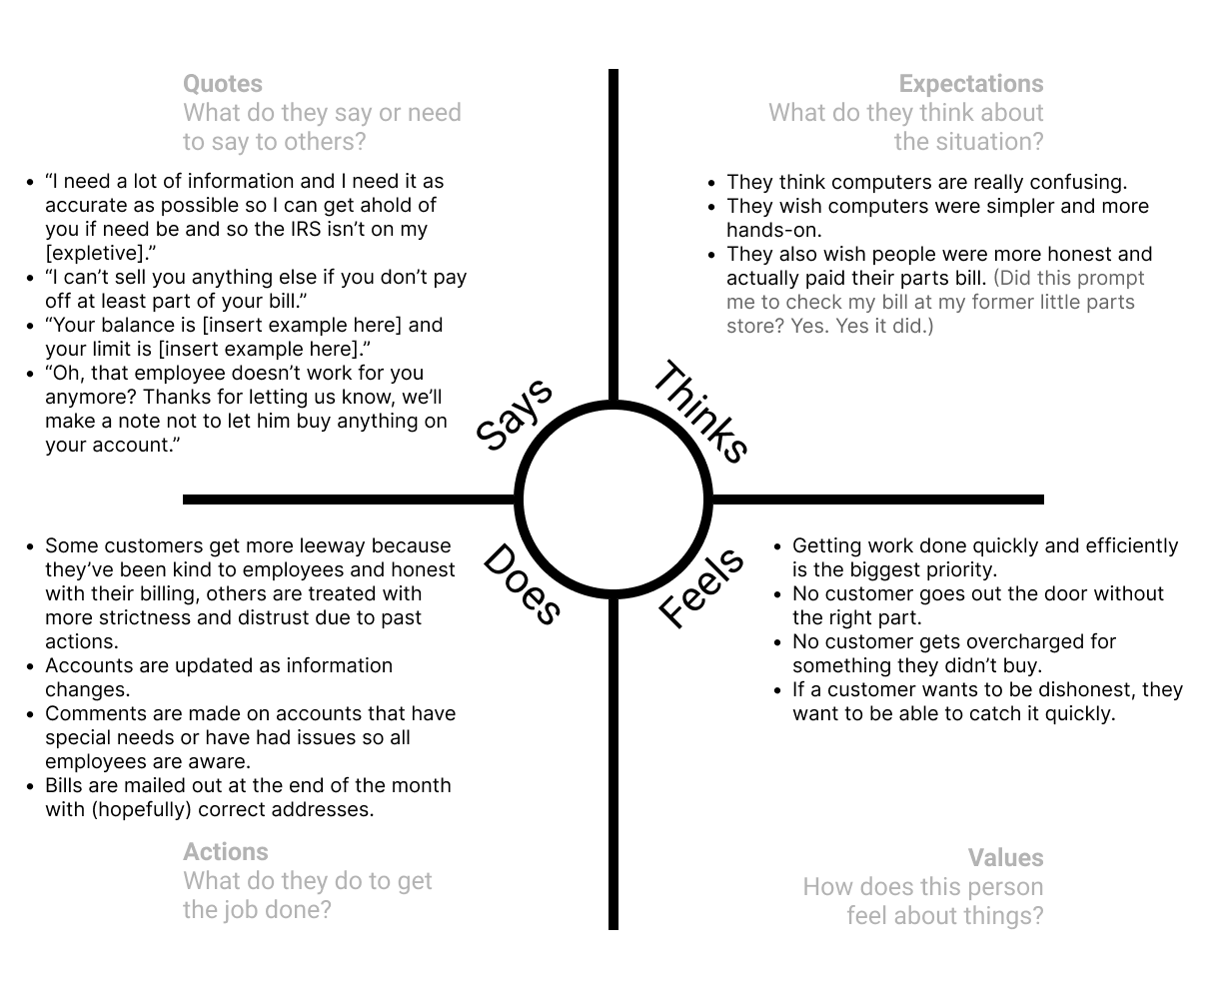
Deliverable 1: Empathy Map

Slide 8
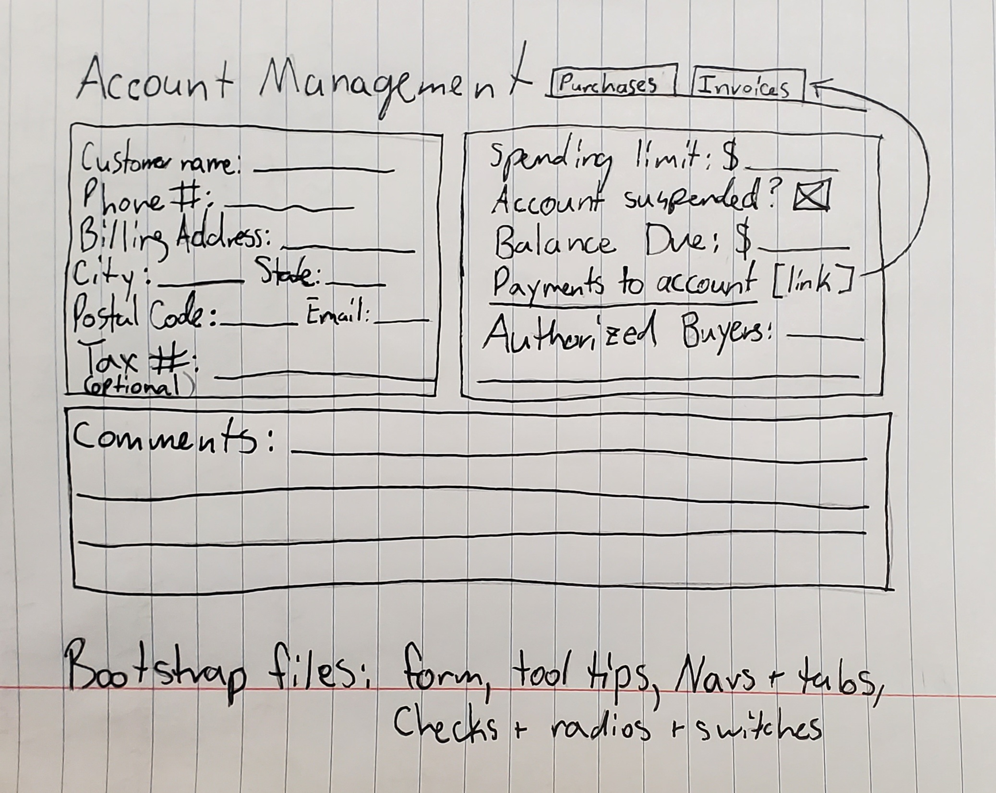
Deliverable 2: Wireframe

